Slide 1

Week 14
Reinforcement Learning
Russell & Norvig, Chapter 21
Slides from: Pieter Abbeel and Dan Klein
Notes:
Please retain proper attribution, including the reference to ai.berkeley.edu. Thanks!

Slide 2
Reinforcement Learning
Agent
State: s
Reward: r
Actions: a
Environment
Basic idea:
Receive feedback in the form of rewards
Agent’s utility is defined by the reward function
Must (learn to) act so as to maximize expected rewards
All learning is based on observed samples of outcomes!

Slide 3
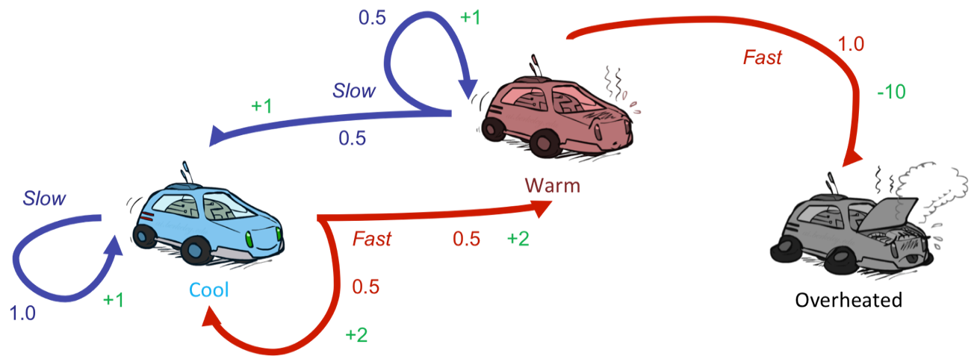
Reinforcement Learning
Still assume a Markov decision process (MDP):
A set of states s ∈ S
A set of actions (per state) A
A model T(s,a,s’)
A reward function R(s,a,s’)
Still looking for a policy π(s)
New twist: don’t know T or R
I.e. we don’t know which states are good or what the actions do
Must actually try out actions and states to learn

Slide 4
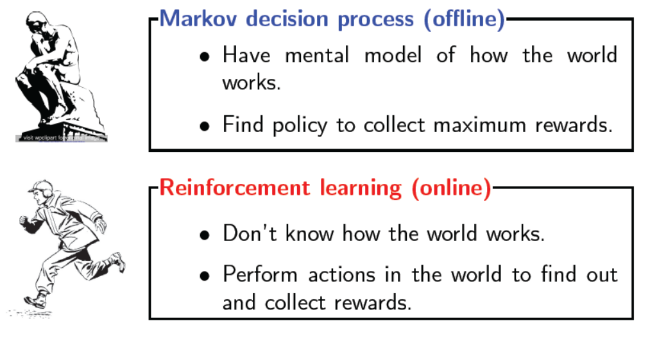
Offline (MDPs) vs. Online (RL)

Slide 5
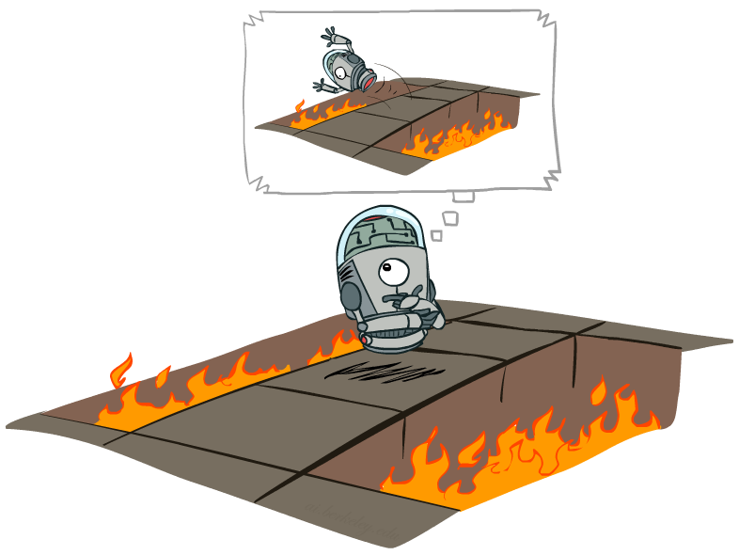
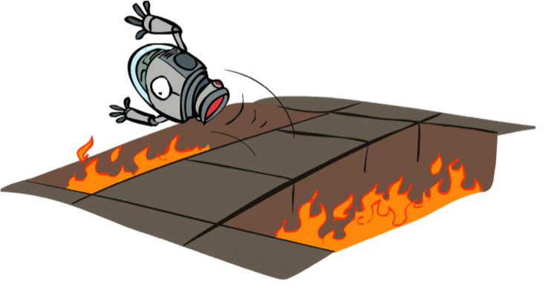
Offline (MDPs) vs. Online (RL)
Offline Solution
Online Learning

Slide 6




Model-Based Learning
Model-Based Idea:
Learn an approximate model based on experiences
Solve for values as if the learned model were correct
Step 1: Learn empirical MDP model
Count outcomes s’ for each s, a
Normalize to give an estimate of
Discover each when we experience (s, a, s’)
Step 2: Solve the learned MDP
For example, use value iteration, as before

Slide 7
Example: Model-Based Learning
Input Policy π
Observed Episodes (Training)
Learned Model
Episode 1
Episode 2
T(s,a,s’).
T(B, right, C) = 1.00
T(C, right, D) = 0.75
T(C, right, A) = 0.25
…
R(s,a,s’).
R(B, right, C) = -1
R(C, right, D) = -1
R(D, exit, x) = +10
…
 | A
B | C | D
 | E
B, right, C, -1
C, right, D, -1
D, exit, x, +10
B, right, C, -1
C, right, D, -1
D, exit, x, +10
Episode 3
Episode 4
E, up, C, -1
C, right, D, -1
D, exit, x, +10
E, up, C, -1
C, right, A, -1
A, exit, x, -10
Assume: γ = 1

Slide 8
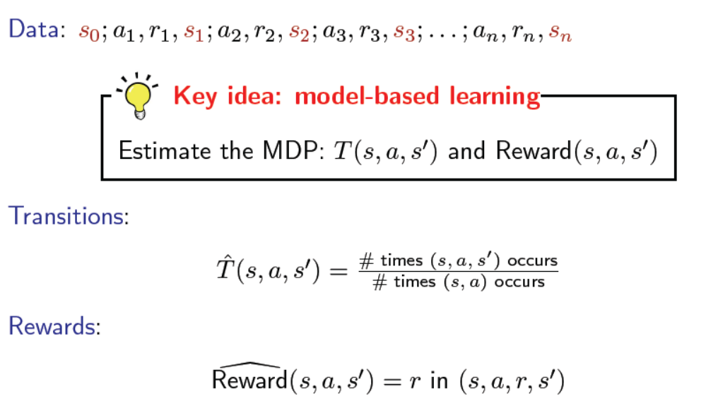
Model-based Monte Carlo

Slide 9

Model-Free Learning

Slide 10
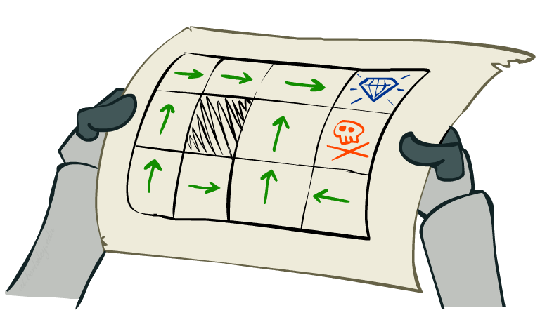
Passive Reinforcement Learning (Section 21.2)
Simplified task: policy evaluation
Input: a fixed policy π(s)
You don’t know the transitions T(s,a,s’)
You don’t know the rewards R(s,a,s’)
Goal: learn the state values
In this case:
Learner is “along for the ride”
No choice about what actions to take
Just execute the policy and learn from experience
This is NOT offline planning! You actually take actions in the world.

Slide 11
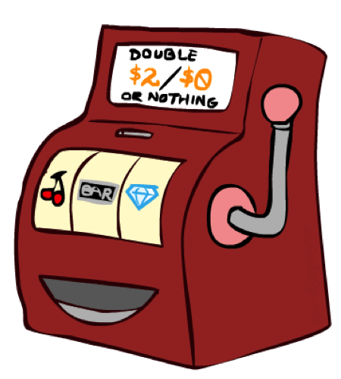
Direct Evaluation
Goal: Compute values for each state under π
Idea: Average together observed sample values
Act according to π
Every time you visit a state, write down what the sum of discounted rewards turned out to be
Average those samples
This is called direct evaluation

Slide 12
Example: Direct Evaluation
Input Policy π
Observed Episodes (Training)
Output Values
Episode 1
Episode 2
 | A
B | C | D
 | E
 | A
B | C | D
 | E
B, east, C, -1
C, east, D, -1
D, exit, x, +10
B, east, C, -1
C, east, D, -1
D, exit, x, +10
-10
+8
+4
+10
Episode 3
Episode 4
-2
E, north, C, -1
C, east, D, -1
D, exit, x, +10
E, north, C, -1
C, east, A, -1
A, exit, x, -10
Assume: γ = 1

Slide 13
Problems with Direct Evaluation
What’s good about direct evaluation?
It’s easy to understand
It doesn’t require any knowledge of T, R
It eventually computes the correct average values, using just sample transitions
What bad about it?
It wastes information about state connections
Each state must be learned separately
So, it takes a long time to learn
Output Values
 | A
B | C | D
 | E
-10
+8
+4
+10
-2
If B and E both go to C under this policy, how can their values be different?

Slide 14

Why Not Use Policy Evaluation?
s
Simplified Bellman updates calculate V for a fixed policy:
Each round, replace V with a one-step-look-ahead layer over V
This approach fully exploited the connections between the states
Unfortunately, we need T and R to do it!
Key question: how can we do this update to V without knowing T and R?
In other words, how to we take a weighted average without knowing the weights?
π(s)
s, π(s)
s, π(s),s’
s’

Slide 15
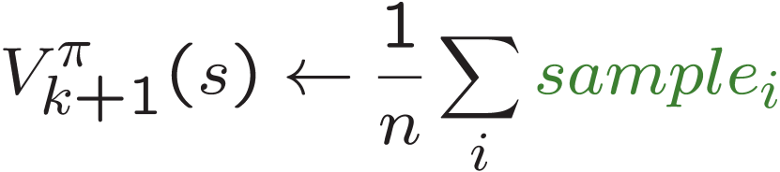
Sample-Based Policy Evaluation?
We want to improve our estimate of V by computing these averages:
Idea: Take samples of outcomes s’ (by doing the action!) and average
s
π(s)
s, π(s)
s, π(s),s’
s₁'
s₂'
s'
s₃'
Almost! But we can’t rewind time to get sample after sample from state s.

Slide 16
Temporal Difference Learning
Big idea: learn from every experience!
Update V(s) each time we experience a transition (s, a, s’, r)
Likely outcomes s’ will contribute updates more often
Temporal difference learning of values
Policy still fixed, still doing evaluation!
Move values toward value of whatever successor occurs: running average
s
π(s)
s, π(s)
s’
Sample of V(s):
Update to V(s):
Same update:

Slide 17
Example: Temporal Difference Learning
States
Observed Transitions
B, east, C, -2
C, east, D, -2
 | A
B | C | D
 | E
 | 0
0 | 0 | 8
 | 0
 | 0
-1 | 0 | 8
 | 0
 | 0
-1 | 3 | 8
 | 0
Assume: γ = 1, α = 1/2
Notes:
R + g V (c)
New sample = -2 + 1 . (0)
0.5 (previous b value (0) + 0.5 (-2))
State c
-2 + 8 = 6

Slide 18
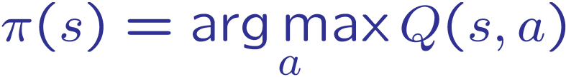
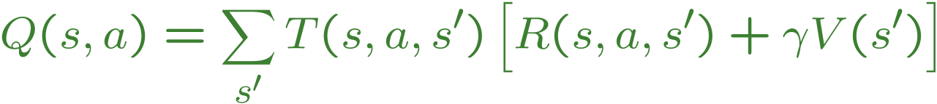
Problems with TD Value Learning
TD value leaning is a model-free way to do policy evaluation, mimicking Bellman updates with running sample averages
However, if we want to turn values into a (new) policy, we’re sunk:
Idea: learn Q-values, not values
Makes action selection model-free too!
s
a
s, a
s,a,s’
s’

Slide 19
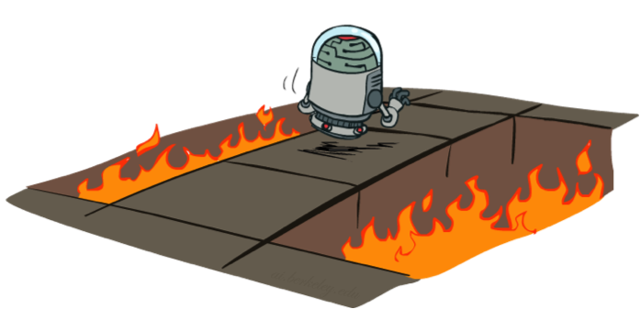
Active Reinforcement Learning (Section 21.3)
Full reinforcement learning: optimal policies (like value iteration)
You don’t know the transitions T(s,a,s’)
You don’t know the rewards R(s,a,s’)
You choose the actions now
Goal: learn the optimal policy / values
In this case:
Learner makes choices!
Fundamental tradeoff: exploration vs. exploitation
This is NOT offline planning! You actually take actions in the world and find out what happens…

Slide 20
Detour: Q-Value Iteration
Value iteration: find successive (depth-limited) values
Start with V₀(s) = 0, which we know is right
Given V_{k}, calculate the depth k+1 values for all states:
But Q-values are more useful, so compute them instead
Start with Q₀(s,a) = 0, which we know is right
Given Q_{k}, calculate the depth k+1 q-values for all q-states:

Slide 21

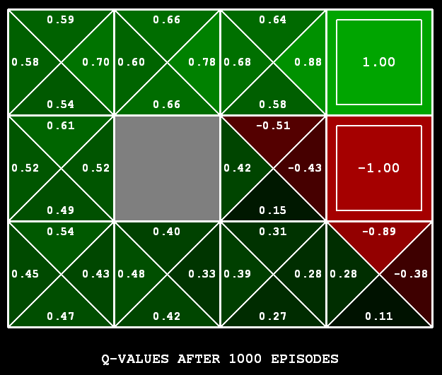
Q-Learning
Q-Learning: sample-based Q-value iteration
Learn Q(s,a) values as you go
Receive a sample (s,a,s’,r)
Consider your old estimate:
Consider your new sample estimate:
Incorporate the new estimate into a running average:
[Demo: Q-learning – gridworld (L10D2)]
[Demo: Q-learning – crawler (L10D3)]

Slide 22

Q-Learning Properties
Amazing result: Q-learning converges to optimal policy -- even if you’re acting suboptimally!
This is called off-policy learning
Caveats:
You have to explore enough
You have to eventually make the learning rate
small enough
… but not decrease it too quickly
Basically, in the limit, it doesn’t matter how you select actions (!)

Slide 23
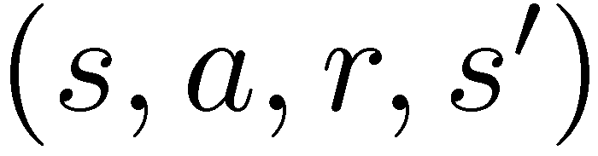
Model-Free Learning
s
Model-free (temporal difference) learning
Experience world through episodes
Update estimates each transition
Over time, updates will mimic Bellman updates
a
s, a
r
s’
a’
s’, a’
s’’

Slide 24
Q learning vs SARSA Learning
We’d like to do Q-value updates to each Q-state:
Q-Learning: sample-based Q-value iteration
Off policy
On policy
Notes:
The difference from Q-learning is quite subtle:
whereas Q-learning backs up the best Q-value from the state reached in the observed transition,
SARSA waits until an action is actually taken and backs up the Q-value for that action.

Slide 25
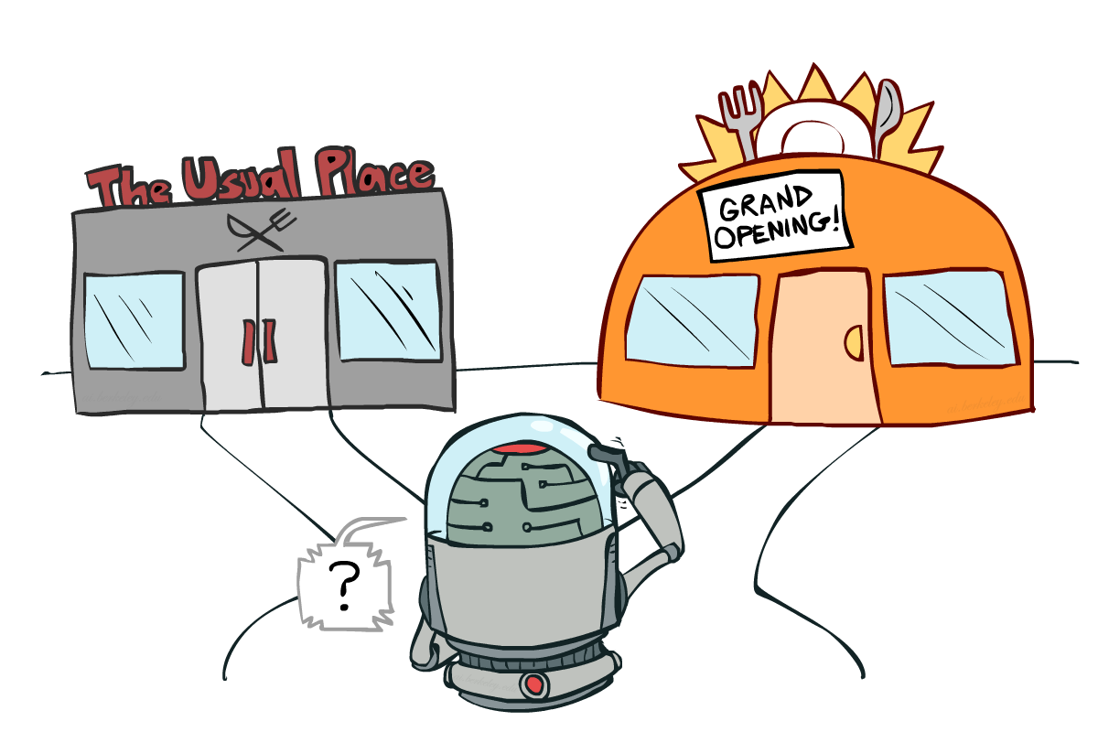
Exploration vs. Exploitation

Slide 26

How to Explore?
Several schemes for forcing exploration
Simplest: random actions (ε-greedy)
Every time step, flip a coin
With (small) probability ε, act randomly
With (large) probability 1-ε, act on current policy
Problems with random actions?
You do eventually explore the space, but keep thrashing around once learning is done
One solution: lower ε over time
Another solution: exploration functions
[Demo: Q-learning – manual exploration – bridge grid (L11D2)] [Demo: Q-learning – epsilon-greedy -- crawler (L11D3)]

Slide 27
Optional Slides
Additional Reading:
Generalizing Across States (Section 21.4)

Slide 28

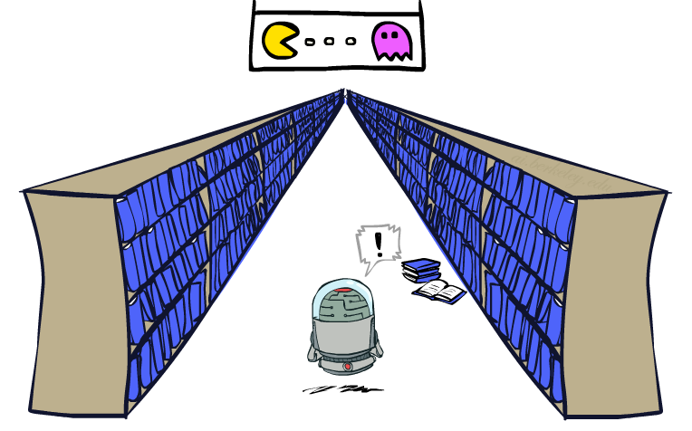
Generalizing Across States (Section 21.4)
Basic Q-Learning keeps a table of all q-values
In realistic situations, we cannot possibly learn about every single state!
Too many states to visit them all in training
Too many states to hold the q-tables in memory
Instead, we want to generalize:
Learn about some small number of training states from experience
Generalize that experience to new, similar situations
This is a fundamental idea in machine learning, and we’ll see it over and over again
[demo – RL pacman]

Slide 29
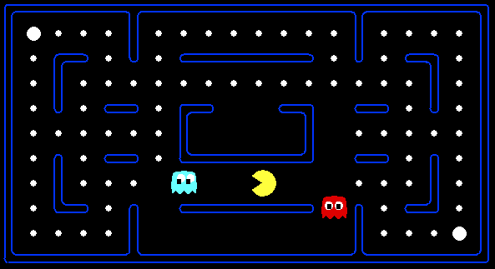



Feature-Based Representations
Solution: describe a state using a vector of features (properties)
Features are functions from states to real numbers (often 0/1) that capture important properties of the state
Example features:
Distance to closest ghost
Distance to closest dot
Number of ghosts
1 / (dist to dot)²
Is Pacman in a tunnel? (0/1)
…… etc.
Is it the exact state on this slide?
Can also describe a q-state (s, a) with features (e.g. action moves closer to food)

Slide 30
Linear Value Functions
Using a feature representation, we can write a q function (or value function) for any state using a few weights:
Advantage: our experience is summed up in a few powerful numbers
Disadvantage: states may share features but actually be very different in value!

Slide 31
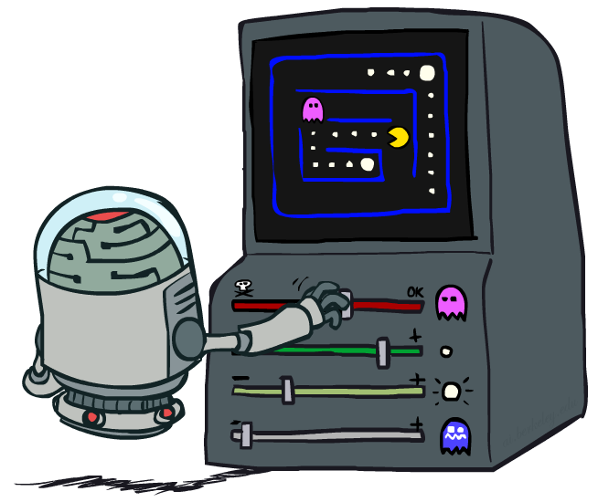
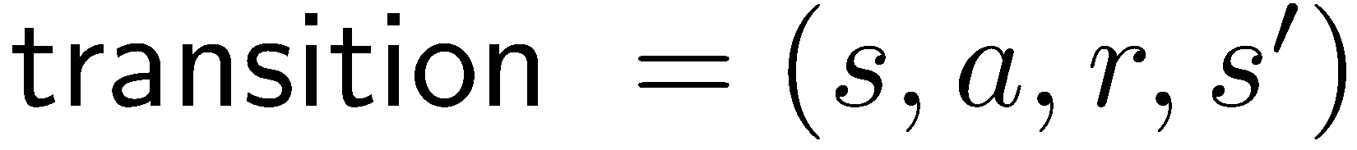
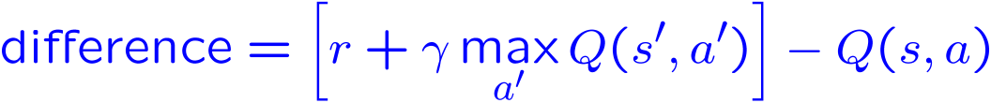
Approximate Q-Learning
Q-learning with linear Q-functions:
Intuitive interpretation:
Adjust weights of active features
E.g., if something unexpectedly bad happens, blame the features that were on: disprefer all states with that state’s features
Formal justification: online least squares
Exact Q’s
Approximate Q’s

Slide 32
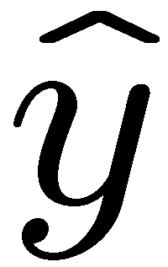
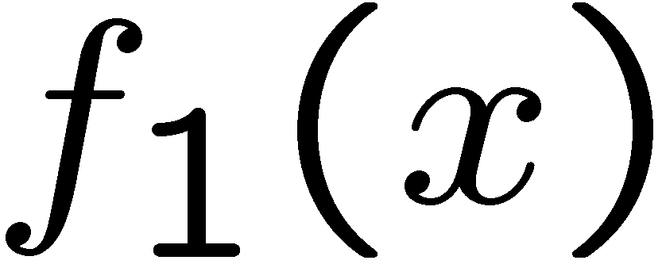
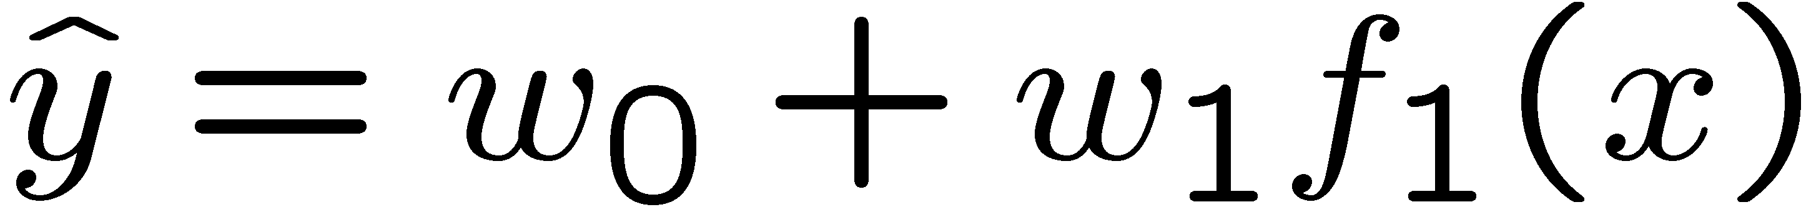
Linear Approximation: Regression*
40
26
24
20
22
20
30
20
40
0
0
20
30
10
20
0
10
0
Prediction:
Prediction:
Notes:
Figure 1: scatter(1:20,10+(1:20)+2*randn(1,20),'k','filled'); a=axis; a(3)=0; axis(a);

Slide 33
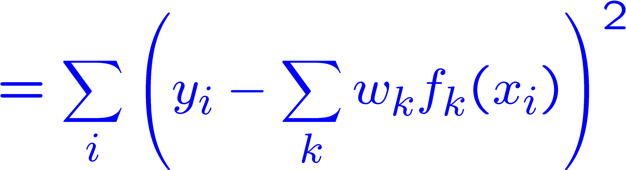
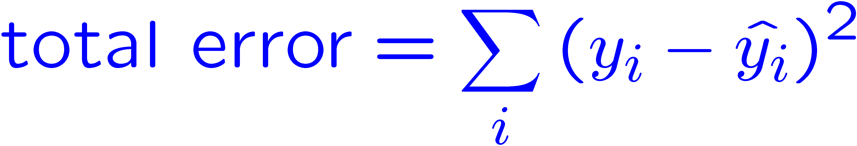
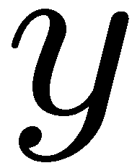
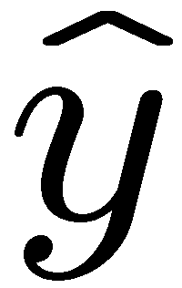

Optimization: Least Squares*
Error or “residual”
Observation
Prediction
0
0
20
Notes:
Figure 1: scatter(1:20,10+(1:20)+2*randn(1,20),'k','filled'); a=axis; a(3)=0; axis(a);

Slide 34
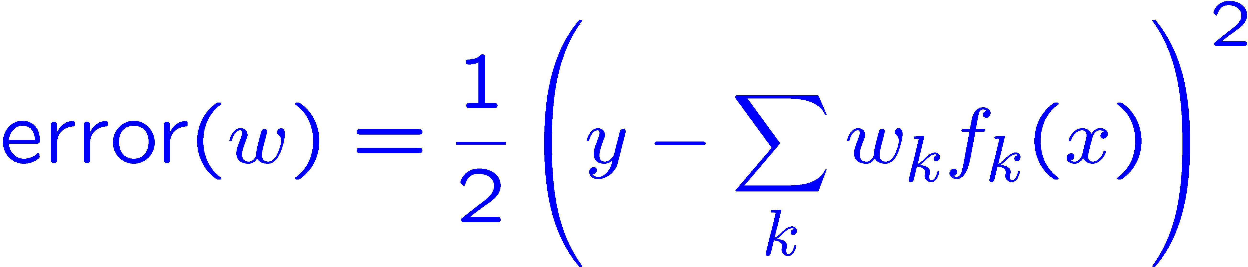
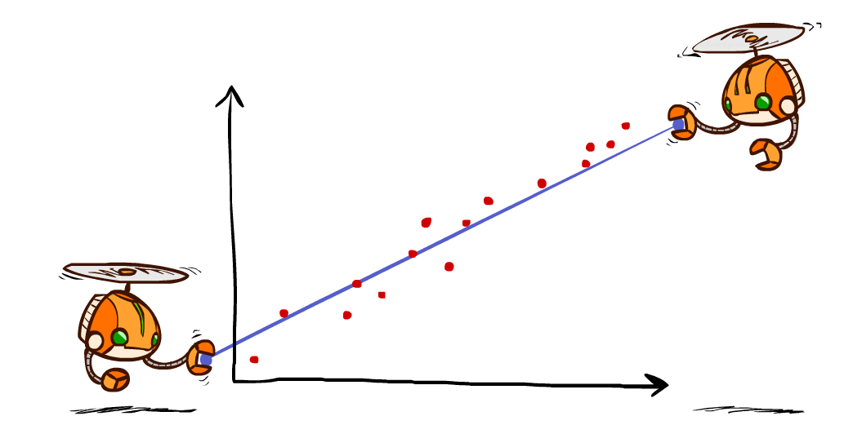
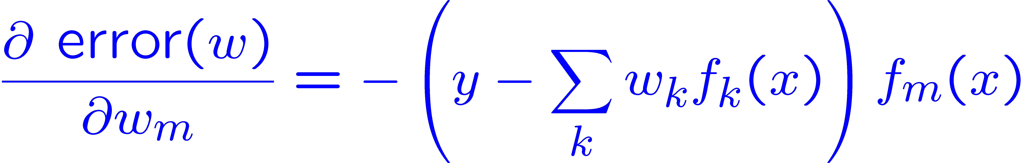
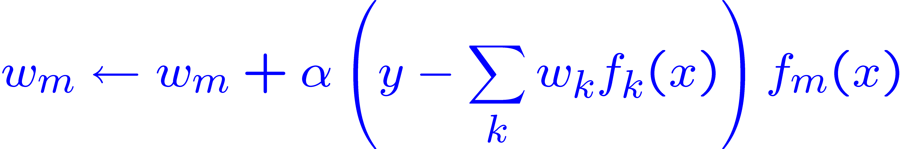
Minimizing Error*
Imagine we had only one point x, with features f(x), target value y, and weights w:
Approximate q update explained:
“target”
“prediction”

